Slide 1




Scrum Awareness
Airbus Amber
Marcos Navarro- Agile Development Team - TEXI
March 2021

Slide 2
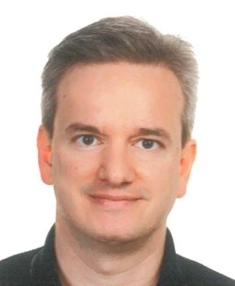
















TEXI - Performance Management & Improvement
MN
Marcos Navarro
Agile Coach
Bremen
BRE
Friedrichshafen
Maik
PURRMANN
Isabell RODENBURG
Sayed
ABOUELELA
Vanessa LUNA JIMENEZ
Marcos NAVARRO
FDH
MAN
Manching
Toulouse
Lars
KÖNNECKE
Christian SPREER
Yvonne
WAMSER
TLS
SOP
Olivier CABRERA
Arnaud
CHIVARD
Eric DUCRET
Isabelle LACAZE
Anne MILLET
Antoine TOULEMONT
Sophia-Antipolis
GET
Getafe
Christian
ORSATTI
Roberto
ENERIZ
Agile
Value Management
Continuous Improvement
Notes:
The Performance Management & Improvement department (TEXI) leads the continuous efficiency improvement activities of Engineering in line with the overall strategy and business goals of the company.
We lead the deployment of consistent and efficient Agile and Value Management mindset and practices across Airbus DS
We lead the deployment of an efficient and useful Performance Management System including Key Performance Indicators on Product Quality, Organization Efficiency and Engineering Portfolio/Projects Performance, to allow proper steering and decisions from the TE Leaders
We lead the deployment of a Risks and Opportunities Management System so as to pro-actively anticipate actions allowing Engineering to mitigate risks impacts and probability, as well as anticipate for future opportunities

Slide 3




Meeting rules
Airbus Amber
Mute when not speaking
But participate and unmute as frequently as needed
When starting speaking, please start with your name
Try to be and stay focus as much as possible

Slide 4



Airbus Amber
The real challenge is to BE Agile rather than DOING Agile
LeSS
DevOps
SCRUM
KANBAN
SAFe
……
Test driven development (TDD)
4 Values
12 Principles
Frameworks
Tools
Methodologies
Mindset
Notes:
KEY MESSAGES:
Don’t get swamped too much by the agile techniques as it’s very easy to focus on the techniques and forget the values and principles
Some organization focus so much on the techniques; that they become non-Agile.
It’s very easy to pretend being agile while only sticking post-its on a wall; but if this is done without respecting the values and principles; this cannot be called Agile
Agile is about how people collaborate towards a common goal, supported by frameworks
Mindset cannot be tought/presented/trained, it is something internal for the people
Values and principles are trying to describe the mindset to give a picture / differetiation
Fameworks and tools incorporate values and principles to make it easier to understand and follow them

Slide 5


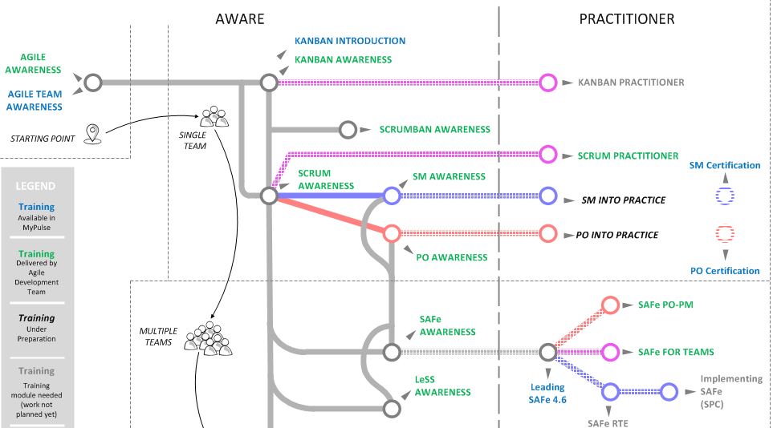




Some of the trainings provided by the Agile Development Team: https://communities.intra.corp/sites/PMT_Engineering/Agile/SitePages/Training_Entry.aspx
Airbus Amber
WE ARE HERE

Slide 6




Airbus Amber
Agile Mindset based on 4 values
Responding to Change
Customer Collaboration
Working Product
Following a Plan
Individuals & interactions
Contract Negotiation
Comprehensive Documentation
Process and Tools
Agile Manifesto (2001)
Notes:
Agile development is often opposed to traditional V-cycle or Waterfall development.
In 2001, a group of process experts gathered to sign the Agile Manifesto.
The Agile Manifesto is the blueprint of the Agile mindset.
The Agile Manifesto start with the following statement:
“We are uncovering better ways of developing software by doing it and helping others do it. Through this work we have come to value:” One important word here is “Software Development”. It shows that Agile applies by design to software development. It does not mean that we cannot be agile in other context but some principles might need to be tailored and may not apply as-is.
Then, the Agile Manifesto states the 4 values:
Individuals and interactions over processes and tools
Working software over comprehensive documentation
Customer collaboration over contract negotiation
Responding to change over following a plan
Last, the Agile Manifesto ends with the following statement which clarifies the way to interpret the 4 values:
“That is, while there is value in the items on the right, we value the items on the left more.” Said differently, the Agile Manifesto recognize value on processes, tools, documentation, contracts and plan but value more individual and interactions, working software, customer collaboration and responding to change.
We would like to insist on this part because there is often a misunderstanding about Agile and some Agile practitioner go up to the statement that processes, tools, documentation, contract and plan are in opposition to agility. Which is wrong, as per the Agile Manifesto.

Slide 7












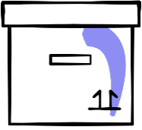

Agile Mindset supported by 12 principles
Airbus Amber
Customer satisfaction
Welcome change
Deliver frequently
Working together
Motivated team
Face-to-face
Working product
Constant pace
Good design
Simplicity
Self-organization
Reflect and adjust
http://agilemanifesto.org/principles.html
Notes:
Our highest priority is to satisfy the customer through early and continuous delivery of valuable software.
Welcome changing requirements, even late in development. Agile processes harness change for the customer's competitive advantage.
Deliver working software frequently, from a couple of weeks to a couple of months, with a preference to the shorter timescale.
Business people and developers must work together daily throughout the project.
Build projects around motivated individuals. Give them the environment and support they need, and trust them to get the job done.
The most efficient and effective method of conveying information to and within a development team is face-to-face conversation.
Working software is the primary measure of progress.
Agile processes promote sustainable development. The sponsors, developers, and users should be able to maintain a constant pace indefinitely.
Continuous attention to technical excellence and good design enhances agility.
Simplicity--the art of maximizing the amount of work not done--is essential.
The best architectures, requirements, and designs emerge from self-organizing teams.
At regular intervals, the team reflects on how to become more effective, then tunes and adjusts its behavior accordingly.

Slide 8
Airbus Amber
Agenda
1 | Scrum Flow Overview
2 | Scrum Flow Part I
3 | Scrum Flow Part II
4 | Summary

Slide 9
Scrum Awareness
Airbus Amber
Scrum Flow Overview

Slide 10












The Scrum Flow – Part I
Airbus Amber
V I S I O N
Product
Owner
Scrum
Master
Refinement
Backlog
Development Team
End-User
Customer
Management
Release Plan
Backlog
Meeting

Slide 11









The Scrum Flow – Part II
Airbus Amber
WHAT?
SPRINT PLANNING I
HOW?
SPRINT PLANNING II
15min
P
DAILY
D
A
SPRINT RETROSPECTIVE
C
IMPROVE PROCESS
SPRINT REVIEW
INSPECT PRODUCT
PLAN
| DO
| CHECK
| ADJUST

Slide 12
Scrum Awareness
Airbus Amber
Scrum Flow Part I

Slide 13
The Scrum Flow – Part I
Airbus Amber
V I S I O N
Product
Owner
Scrum
Master
Refinement
Backlog
Development Team
End-User
Customer
Management
Release Plan
Backlog
Meeting

Slide 14
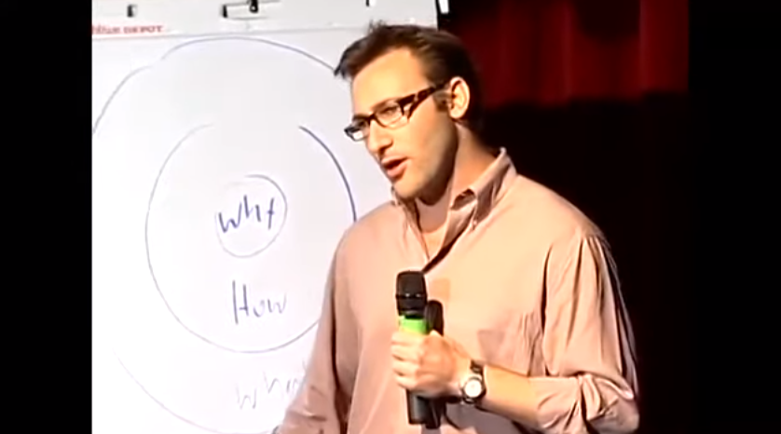
The Scrum Flow – Part I
Airbus Amber
V I S I O N
START with the WHY…
Why? = The purpose
What is your cause? What are your values?
How? = The process
The specific actions to realize the Why
What?
What do you do? The result of Why. The proof
Notes:
Most companies communicate their ideas starting from the most concrete element: what they want to do. Then they explain how they’re going to achieve that. Finally, they try to explain why they actually do what they do.
Sinek explains that the greatest leaders and brands do it the opposite way: they start with explaining why they do what they do.
It is this reversal of order that allows these leaders to sell a vision instead of a product, and that’s what eventually makes their pitch so effective.
Here’s how you can apply the golden circle concept to your brand:
Why: Very few people or companies can clearly articulate why they do what they do. This isn’t about running a profitable company—that’s a result. Why is all about your purpose. Why does your company exist? Why do you get out of bed in the morning? And why should anyone care?
How: Some people and companies know how they do what they do. Whether you call them a ‘’differentiating value proposition’’ or a ‘’unique selling proposition,’’ HOWs are often given to explain how something is different or better.
What: Every single company on the planet knows what they do. This is true no matter how big or small the company is, or no matter what industry they belong to. Everyone can easily describe the products or services their company sells or the job function they have within the company.
When we start with “Why”, we go from the inside out of the circle. “Why” is the reason to buy and the “Whats” merely represent the tangible products as a proof of that belief. “Whats” are the reasons we can point to rationalize why we so much like a company over another.
Simon Sinek cites the example of Apple. In his opinion, Apple is technically no different from its competitors. But Apple communicates from the “Why.” Apple’s “Why” is to challenge the status quo and empower the individual. And their challenging the status quo is a pattern repeating in all they say and do, which is the reason why people perceive Apple as authentic.

Slide 15






Product Vision, Roadmap & Backlog
Product Backlog
Airbus Amber
E
P
3
high
1
V I S I O N
Product Vision
2
8
Clarifies the intended customer needs fulfilled by the product, the “WHY” the product exists
5
Priority
13
21
?
low
Product Roadmap
Dynamic list of backlog items (features/enablers):
Prioritized (business value from the customer)
Estimated (by the team)
Owned by the Product Owner (PO)
Contains a high-level intended view of features / capabilities that will be fulfilled by the various versions and variants of the product
Notes:
KEY MESSAGES:
It all starts with the Product Vision, which then gets transformed into a Product Backlog
Vision The vision statement describes what the organisation will become in the future. It is a broad and inspirational statement intended to engender support from stakeholders.
Mission The mission statement defines how the organisation differentiates itself from other organisations in its industry. It is more specific than the vision statement and is intended to show how stakeholders’ needs will be satisfied.
Example: TESLA
Mission: To create the most compelling car company of the 21st century by driving the world’s transition to electric vehicles.
Vision: To accelerate the world’s transition to sustainable energy.
Example: IKEA
Mission: Offer a wide range of well-designed, functional home furnishing products at prices so low that as many people as possible will be able to afford them.
Vision: To create a better everyday life for the many people.
https://pforgeipt.intra.airbusds.corp/confluence/display/TGA/Connected+Intelligence+-+Digital+Solutions

Slide 16



Role – The Product Owner
Airbus Amber
Mission
The Product Owner owns the vision of the product and ensures the Agile Team delivers the expected value to the customer.
Responsibility
Deliveries
Define the Product Vision and maintain the Product Roadmap
Define the Backlog Items with Acceptance Criteria and Business Value
Prioritize the Product Backlog in line with the Product Vision
Perform acceptance of delivered backlog items
Provide valuable feedback during the Product Demo
Product Vision
Product Roadmap
Prioritized Product Backlog

Slide 17
The Scrum Flow – Part I
Airbus Amber
V I S I O N
Product
Owner
Scrum
Master
Refinement
Backlog
Development Team
End-User
Customer
Management
Release Plan
Backlog
Meeting

Slide 18



Ceremonies – Backlog Refinement
Airbus Amber
Goal
Update the Product Backlog according to newly gained knowledge or additional information.
Content
Participants
Removing product backlog items not relevant anymore
Adding items to the product backlog for new needs
Assessment and update of priorities in the Product Backlog
Update of estimations if background changed
Splitting of Product Backlog Items to fit in Sprints
Development
Team
those needed
Product Owner
Scrum Master
optional
Duration
Maximum 10% of the Sprint time for the developers.

Slide 19
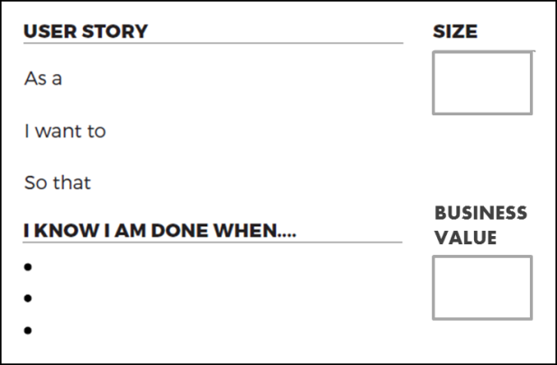
User Story
Airbus Amber
User stories are feature or functionalities that written from the end-user perspective, and it is the smallest unit of product development
Description
User stories can be expressed in a simple sentence, structured as follows:
“As a <particular class of user>, I want to <be able to perform/do something> so that <I get some form of value or benefit>”
Acceptance criteria
It is a checklist per User Story that determine if all the parameters of a User Story and determine when a User Story is working and represents the conditions of satisfaction
Estimation (from the team)
Value (from the customer)

Slide 20



Managing the backlog: Definition of Ready (DoR)
Airbus Amber
What is?
Is a check list of the types of work that the team is expected to complete before it can declare a PBI to be
ready to be moved into a sprint (ready to work on it)
Characteristics
Example
Helps Ensures the Team confidently commit and complete the PBI by the end of a sprint
Should be agreed by the Scrum team
Business value is clearly articulated
Details are sufficiently understood by the Dev. Team so it can complete the PBI
Dependencies are identified and no external dependencies would block the PBI from being completed
Team is staffed appropriately to complete the PBI
The PBI is estimated and small enough to comfortably be completed in one sprint
Acceptance criteria are clear and stable
Scrum team understands how to demonstrate the PBI at the sprint review
Notes:
Notes for facilitation:
“product functionality” means something that has been designed, built, integrated, tested and documented
Example:
DoD for a car workshop:
Car has been testted in the road
Car ha been cleaned
Car has nothing belonging to the workshop inside
Customer has been contacted
Despite of any work that could have been done on the car (service, reparation, check…) this DoD shuld be apply in the same way that a all user stories need to fulfill the DoD despite of the diferent Acceptance Criteria of each of them.

Slide 21
Role – The Scrum Master
Airbus Amber
Mission
The Scrum Master is a servant-leader who enables the team deliver value effectively and efficiently.
Responsibility
Deliveries
Reinforce the ways of working agreed in the team
Help the team focus on the Sprint Goals
Protects the Development Team against outside interference
Support monitoring progress and resolving impediments
Facilitate Scrum rituals
Produce Scrum KPIs
Team capacity allocation
Team velocity chart
Sprint Burndown
Feature burn-up
Risks (or Impediments) List

Slide 22
Role – The Development Team
Airbus Amber
Mission
The development team has the mission to design, develop, test and deliver the product in line with the product vision.
Responsibility
Deliveries
Estimate backlog items
Refine backlog items
Design product elements
Implement product elements
Create test procedures and scripts
Test product elements
Document product usage and installation
Product deliveries
Supporting documentation
Team supporting tools

Slide 23
Scrum Roles & Stakes - Summary
Airbus Amber
Scrum
Master
Customer
Budget (and feedback)
Efficiency
Product
Owner
End-User
ROI → Vision & Backlog
Feedback
Development Team
Management
Quality (self-organized & cross-functional)
Frame & Environment
SCRUM TEAM

Slide 24
Scrum Awareness
Airbus Amber
Scrum Flow Part II

Slide 25
The Scrum Flow – Part II
Airbus Amber
WHAT?
SPRINT PLANNING I
HOW?
SPRINT PLANNING II
15min
P
DAILY
D
A
SPRINT RETROSPECTIVE
C
IMPROVE PROCESS
SPRINT REVIEW
INSPECT PRODUCT
PLAN
| DO
| CHECK
| ADJUST

Slide 26

Ceremonies – Sprint Planning
Airbus Amber
Goal
The development team has selected the Product Backlog items they can achieve in the sprint and has broken them down in small steps.
Content
Participants
Sprint Planning part - I
What can be done this Sprint?
The entire Scrum team planes the upcoming Sprint
Only the Development Team can assess what is doable in the Sprint
Sprint Planning part - II
How will the chosen work be done?
The Development Team breaks the selected Product Backlog items down to better understand the necessary steps
Development
Team
Product Owner
Mandatory for part I, optional for Part II
but available for questions
Scrum Master
Duration
Time-boxed to eight hours for a one month Sprint.

Slide 27
Artefact – Sprint Backlog
Airbus Amber
The Sprint Backlog is a subset of selected Product Backlog items, plus the break down to create a more detailed plan for the implementation.
To-Do | Doing | Done
Time-Box
Contains all tasks that will be done in the current Sprint
Visibility
The current progress towards the Sprint goal is always visible
Up-to-date
Is update during the Daily Scrum / Stand-Up
Responsibility
Only the development team is responsible for this backlog. No one is allowed to add, change or remove something

Slide 28
Managing the backlog: Definition of Done
Airbus Amber
What is?
Is a check list of the types of work that the team is expected to complete before it can declare its work to be
potentially shippable
Characteristics
Example
Ensures everyone on the Team knows exactly what is expected of everything the Team delivers.
Applies to the “product increment” and apply to all the PBIs.
Should show a slide of product functionality that delivers value to the customer.
Promotes that the team build high quality and shippable product.
Can evolve over time.
Should be free from external dependencies.
Design is reviewed
Code completed
Code refactored
Code is commented
…
End-user documentation updated
Tested
Unit tested
Integration tested
…
Zero known defects
Acceptance tested
Live on production servers
Notes:
Notes for facilitation:
“product functionality” means something that has been designed, built, integrated, tested and documented
Example
DoD for a car workshop:
Car has been testted in the road
Car ha been cleaned
Car has nothing belonging to the workshop inside
Customer has been contacted
Despite of any work that could have been done on the car (service, reparation, check…) this DoD shuld be apply in the same way that a all user stories need to fulfill the DoD despite of the diferent Acceptance Criteria of each of them.
Examples of Definition of Done and the Acceptance Criteria
Definition of Done
Code Builds without error warning
Code is Unit Tested
Code is Deployed to system test environment and passed system tests
Build pushed to demo server
Remaining hours of the User Story are marked zero
Acceptance Criteria
A user cannot submit a form without completing all the mandatory fields
Information from the form is stored in the registrations database
Payment can be made via credit card
An acknowledgment email is sent to the user after submitting the form

Slide 29
The Scrum Flow – Part II
Airbus Amber
WHAT?
SPRINT PLANNING I
HOW?
SPRINT PLANNING II
15min
P
DAILY
D
A
SPRINT RETROSPECTIVE
C
IMPROVE PROCESS
SPRINT REVIEW
INSPECT PRODUCT
PLAN
| DO
| CHECK
| ADJUST

Slide 30

Ceremonies – Daily Scrum / Stand-Up
Airbus Amber
Goal
Support the self-organised development team and have them synchronized, on what activities happened and what's the plan until the next Daily Scrum / Stand-Up
Content
Participants
Everybody from the Development Team answers the following questions:
What did I do since the last Daily Scrum / Stand-Up?
What will I do until the next Daily Scrum / Stand-Up to support the team reach the Sprint goal?
Do I see or have any impediment that blocks us from reaching the Sprint goal?
Development
Team
Product Owner
Optional
Only listening
Scrum Master
Duration
Always same time, same place and a maximum of 15 min.

Slide 31
The Scrum Flow – Part II
Airbus Amber
WHAT?
SPRINT PLANNING I
HOW?
SPRINT PLANNING II
15min
P
DAILY
D
A
SPRINT RETROSPECTIVE
C
IMPROVE PROCESS
SPRINT REVIEW
INSPECT PRODUCT
PLAN
| DO
| CHECK
| ADJUST

Slide 32


Ceremonies – Sprint Review
Airbus Amber
Goal
Inspect what the team has achieved in the Sprint (the product) and adapt the Product Backlog if needed.
Content
Participants
Overview:
Give an overview what has been achieved & done in the Sprint
Show how this increment contributes to the bigger picture
Presentation:
Demo the result of the Sprint
Do not focus on showing slides but rather on showing the product itself
Concentrate on the user (end-to-end context)
Foster discussions and exchange on the increment
Development
Team
Product
Owner
Scrum
Master
Stakeholder/
Customer
Duration
Time-boxed to four hours for a one month Sprint.

Slide 33

Artefact – Burn Down Chart
Airbus Amber
The Burn-Down chart compares current progress, with planned progress.
Sprint Burn Down
Visualizes the progress of the current Sprint. The team sees if they are on track to reach the committed Sprint goal.
Options:
Based on number of tasks
Based on estimated effort in hours
Based on number of User Stories
Based on estimation of User Stories
Release Burn Down
By tracking the burn down rate over multiple Sprints, an extrapolation can be done to estimate the content of an upcoming release.

Slide 34

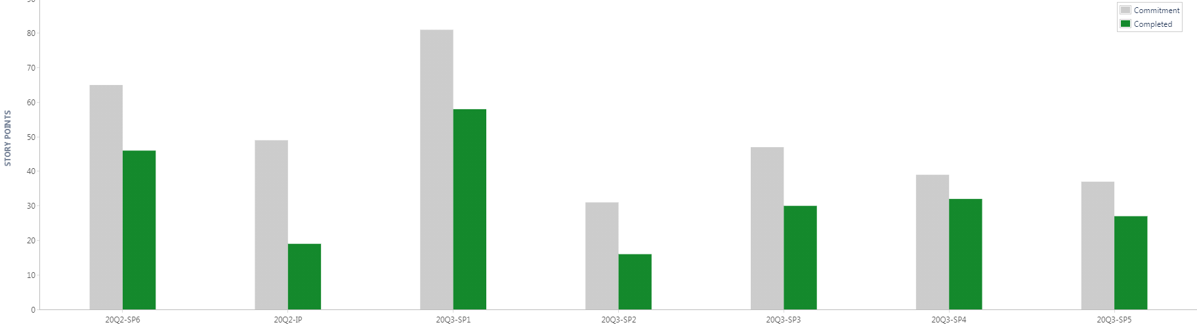
Measuring velocity - Tipp's
Airbus Amber
Do not count unfinished items. This reinforce the idea that non-finished work is a waste.
PO decides if non user stories items (bugs, refactoring…) are adding value and should be taken into account.
Use estimated effort and not real. This is key to allow refining the estimation method.
To calculate it:
Velocity= # Story points or hrs. finished in the sprint
Will be used to predict the work that can be done based in “Yesterday’s weather”
Can be calculated based in previous sprint or with average of 2-3 sprints
Do not plan for more that 80% of the estimated capacity
Notes:
References:
Steve McConnell
See methods for estimation for software:
Euristic:
Expert
Analogy
Parametric:
COCOMO (Constructive Cost Model) II by Boehmn
SLIM (Software Lifechcle Management) by Putnam

Slide 35
The Scrum Flow – Part II
Airbus Amber
WHAT?
SPRINT PLANNING I
HOW?
SPRINT PLANNING II
15min
P
DAILY
D
A
SPRINT RETROSPECTIVE
C
IMPROVE PROCESS
SPRINT REVIEW
INSPECT PRODUCT
PLAN
| DO
| CHECK
| ADJUST

Slide 36

Ceremonies – Sprint Retrospective
Airbus Amber
Goal
Inspect the way of working of the Scrum Team and create a plan / identify activities to adapt and improve.
Content
Participants
Focus can be anything apart from the product under development. This can be people, relationships, processes or tools.
Identify what went well in the last Sprint and were is potential to improve.
Create a set of step to implement improvements.
Development
Team
Product
Owner
Scrum
Master
Duration
Time-boxed to three hours for a one month Sprint.

Slide 37
Scrum Awareness
Airbus Amber
Summary

Slide 38
The Scrum Flow – Part I
Airbus Amber
V I S I O N
Product
Owner
Scrum
Master
Refinement
Backlog
Development Team
End-User
Customer
Management
Release Plan
Backlog
Meeting

Slide 39
The Scrum Flow – Part II
Airbus Amber
WHAT?
SPRINT PLANNING I
HOW?
SPRINT PLANNING II
15min
P
DAILY
D
A
SPRINT RETROSPECTIVE
C
IMPROVE PROCESS
SPRINT REVIEW
INSPECT PRODUCT
PLAN
| DO
| CHECK
| ADJUST

Slide 40
Scrum Roles & Stakes - Summary
Airbus Amber
Scrum
Master
Customer
Budget
Efficiency
Product
Owner
End-User
ROI → Vision & Backlog
Feedback
Development Team
Management
Quality (self-oganized & cross-functional)
Frame & Environment
SCRUM TEAM

Slide 41
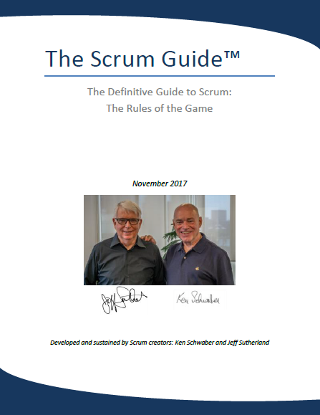
Airbus Amber
Notes:
There is a new one from 2020!

Slide 42
Thank you!
Airbus Amber

